Slide 1



377 Operating Systems
Join on Zoom if you are remote (see website for link).
Process Abstraction and API

Slide 2
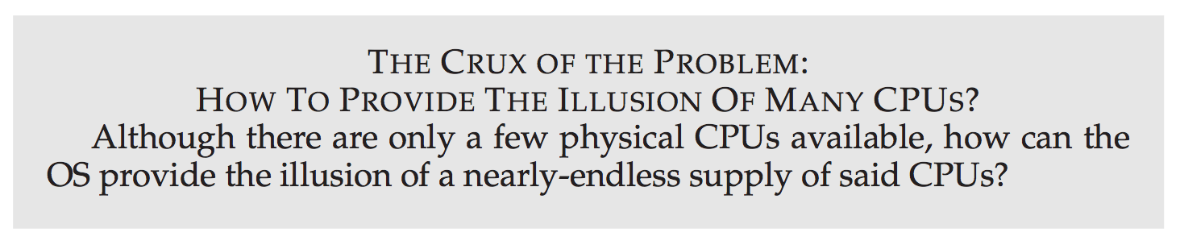
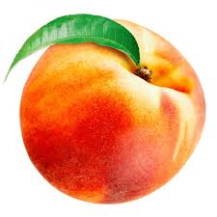

Slide 3
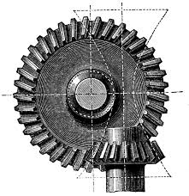

Virtualizing the CPU
Time Sharing
The OS can promote the illusion that many virtual CPUs exist.
The OS runs one process, stops it, then runs another, and so on.
Implementing Virtualization
Low-level machinery and high-level intelligence.
Mechanisms: low-level methods implementing a needed piece of machinery.
Context Switch
Policies: algorithms for making decisions within the OS
Which program should the OS run?
Scheduling Policies
Historical information, workload knowledge, and performance metrics

Slide 4
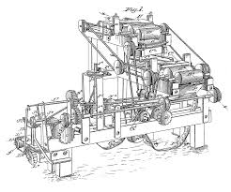
The Abstraction: A Process
A Process
An instance of a running program. At any moment in time, we can summarize a process by taking an inventory of the different pieces of the system it accesses or effects during execution.
Machine State
What parts of the machine are important to the execution of the program.
What can a program read or update when it is running?
Memory: data & instructions, also known as its address space.
Registers: program counter (PC), stack pointer, frame pointer, etc.
Persistent Storage: I/O information such as open files.

Slide 5
Process API
Create
Destroy
Wait
Miscellaneous Control
Status

Slide 6
Process API
Create: An operating system must include some method to create new processes. When you type a command into the shell, or double-click on an application icon, the OS is invoked to create a new process to run the program you have indicated.
Destroy
Wait
Miscellaneous Control
Status

Slide 7
Process API
Create
Destroy: As there is an interface for process creation, systems also provide an interface to destroy processes forcefully. Of course, many processes will run and just exit by themselves when complete; when they don’t, however, the user may wish to kill them, and thus an interface to halt a runaway process is quite useful.
Wait
Miscellaneous Control
Status

Slide 8
Process API
Create
Destroy
Wait: Sometimes it is useful to wait for a process to stop running; thus some kind of waiting interface is often provided.
Miscellaneous Control
Status

Slide 9
Process API
Create
Destroy
Wait
Miscellaneous Control: Other than killing or waiting for a process, there are sometimes other controls that are possible. For example, most operating systems provide some kind of method to suspend a process (stop it from running for a while) and then resume it (continue it running).
Status

Slide 10
Process API
Create
Destroy
Wait
Miscellaneous Control
Status: There are usually interfaces to get some status information about a process as well, such as how long it has run for, or what state it is in.

Slide 11
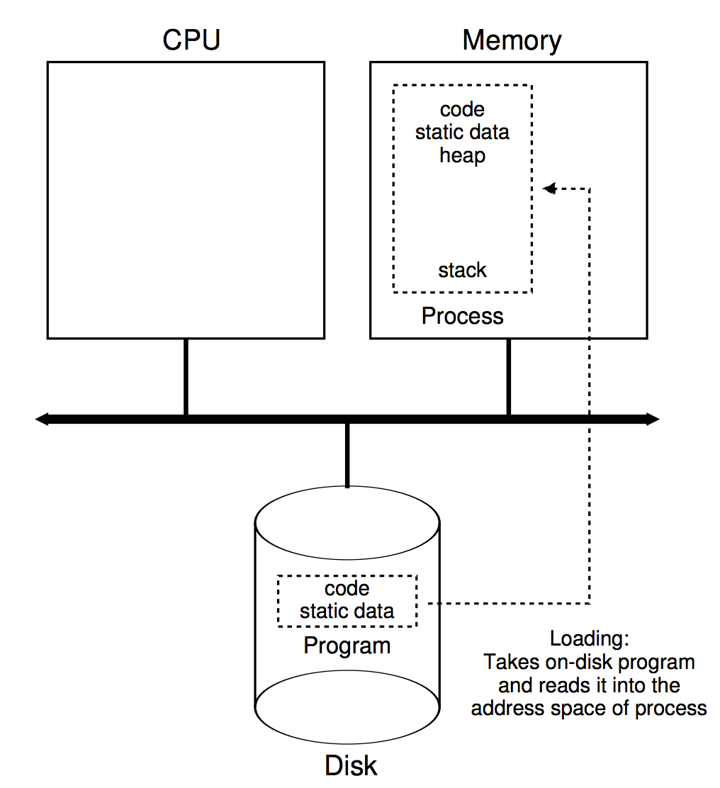
Process Creation: Loading
The first thing the OS must do is load its code and any static data into memory - the address space of the process.
Early operating systems performed this task eagerly, whole program.
A modern OS performs this lazily, by loading pieces of code and data as they are needed.

Slide 12
Process Creation: Memory Allocation
The next step is to allocate important memory regions for the process.
Stack: for storing local variables and function parameters and return values.
Heap: for dynamically allocated data.

Slide 13
Process Creation: Initialization
The OS will also do some other initialization tasks, particularly as related to input/output (I/O).
For example, in UNIX systems, each process by default has three open file descriptors, for standard input, output, and error
these descriptors let programs easily read input from the terminal as well as print output to the screen.

Slide 14
Process Ready
The OS has now set the stage for program execution. It thus has one last task: to start the program running at the entry point.
Historically, a special function called main().
By "jumping" to the main() routine, the OS transfers control of the CPU to the newly-created process, and thus the program begins its execution.
main() { … }

Slide 15
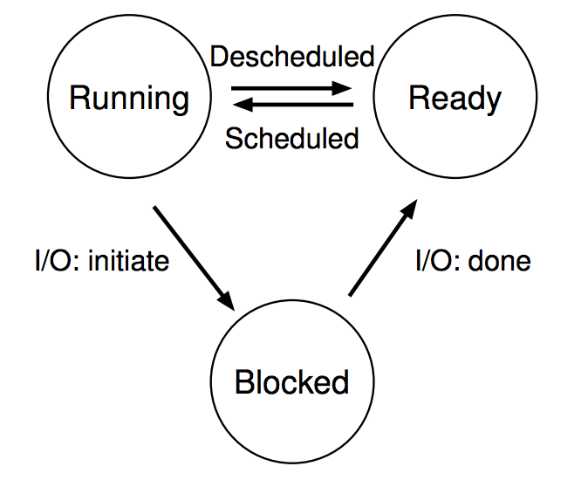
Process States
In a simplified view a process can be in one of three states:
Running
Ready
Blocked

Slide 16
Process States
In a simplified view a process can be in one of three states:
Running: In the running state, a process is running on a processor. This means it is executing instructions.
Ready
Blocked

Slide 17
Process States
In a simplified view a process can be in one of three states:
Running
Ready: In the ready state, a process is ready to run but for some reason the OS has chosen not to run it at this given moment.
Blocked

Slide 18
Process States
In a simplified view a process can be in one of three states:
Running
Ready
Blocked: In the blocked state, a process has performed some kind of operation that makes it not ready to run until some other event takes place. Example: when a process initiates an I/O request to a disk, it becomes blocked and thus some other process can use the processor.

Slide 19
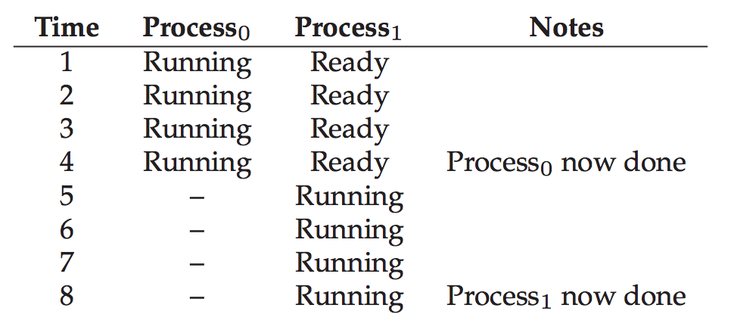
Tracing Process State: CPU Only

Slide 20
Tracing Process State: CPU Only

Slide 21
Tracing Process State: CPU Only

Slide 22
Tracing Process State: CPU Only

Slide 23
Tracing Process State: CPU Only

Slide 24
Tracing Process State: CPU Only

Slide 25
Tracing Process State: CPU Only

Slide 26
Tracing Process State: CPU Only

Slide 27
Tracing Process State: CPU Only

Slide 28
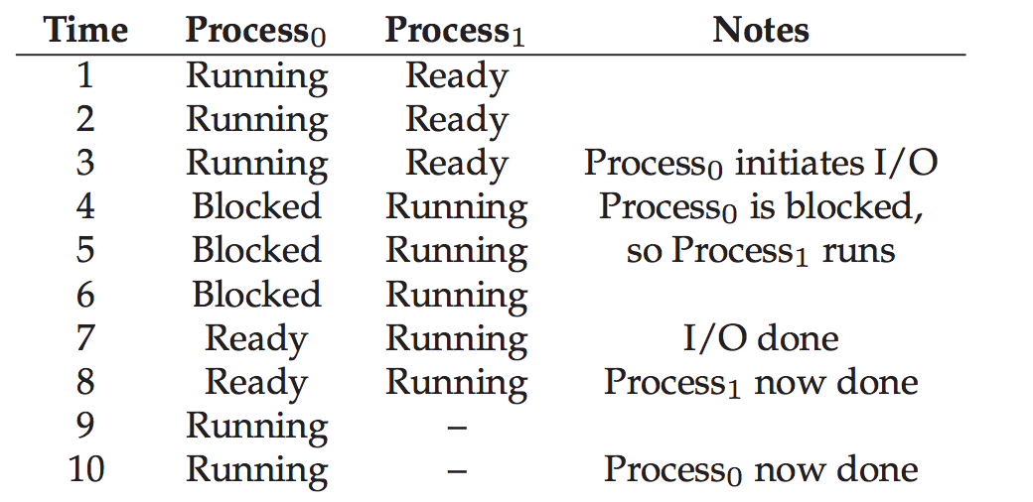
Tracing Process State: CPU and I/O

Slide 29
Tracing Process State: CPU and I/O

Slide 30
Tracing Process State: CPU and I/O

Slide 31
Tracing Process State: CPU and I/O

Slide 32
Tracing Process State: CPU and I/O

Slide 33
Tracing Process State: CPU and I/O

Slide 34
Tracing Process State: CPU and I/O

Slide 35
Tracing Process State: CPU and I/O

Slide 36
Tracing Process State: CPU and I/O

Slide 37
Tracing Process State: CPU and I/O

Slide 38
Data Structures
Operating Systems are rich in data structures!
To provide an abstraction for a processes we require a data structure!
Process Control Block: C structure that contains information about each process.
Process List: Keeps track of all processes (PCBs) in the running system.

Slide 39
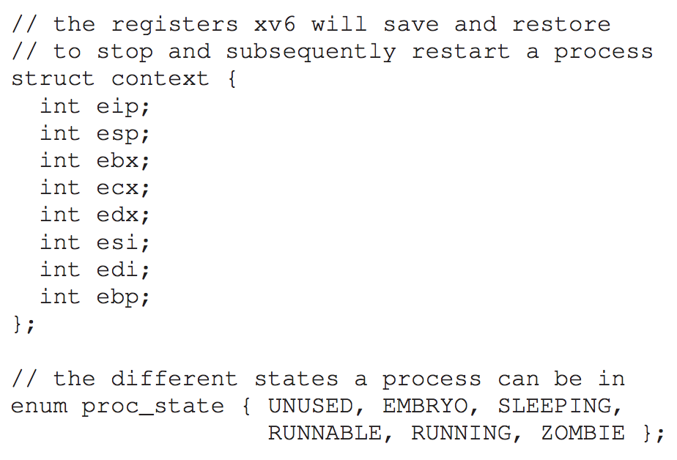
Example: Xv6* OS Proc Structure
* Xv6 is a UNIX-like OS from MIT.

Slide 40
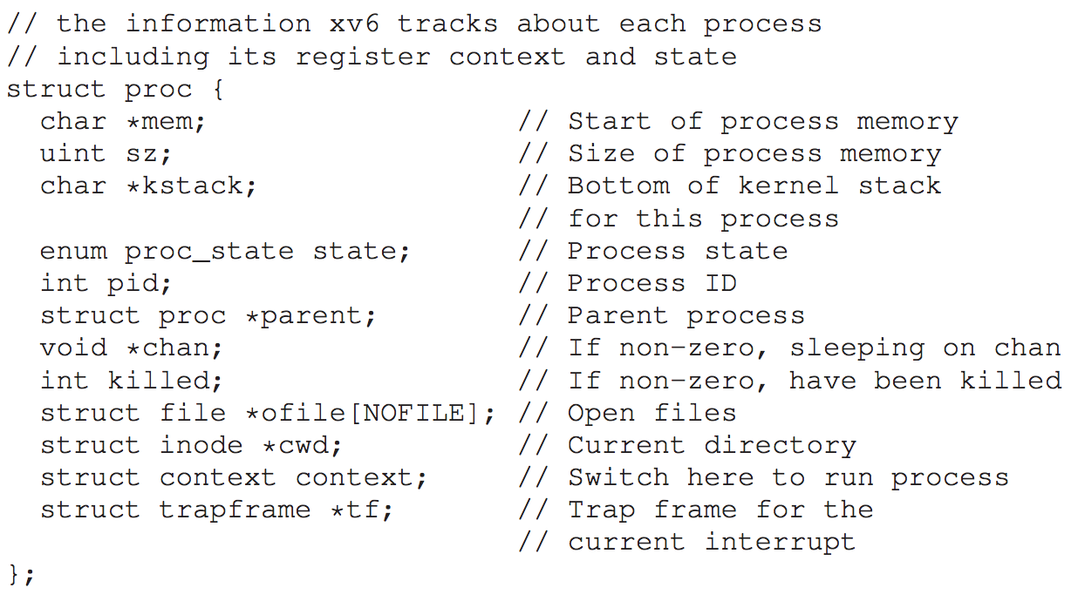
Example: Xv6 OS Proc Structure

Slide 41
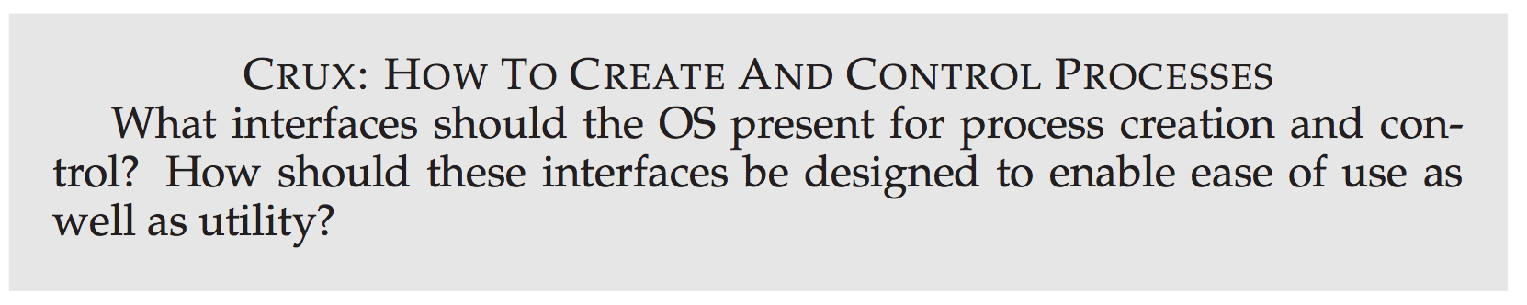

Slide 42

The End

